Slide 1
Jetson Platform Introduction

Slide 2
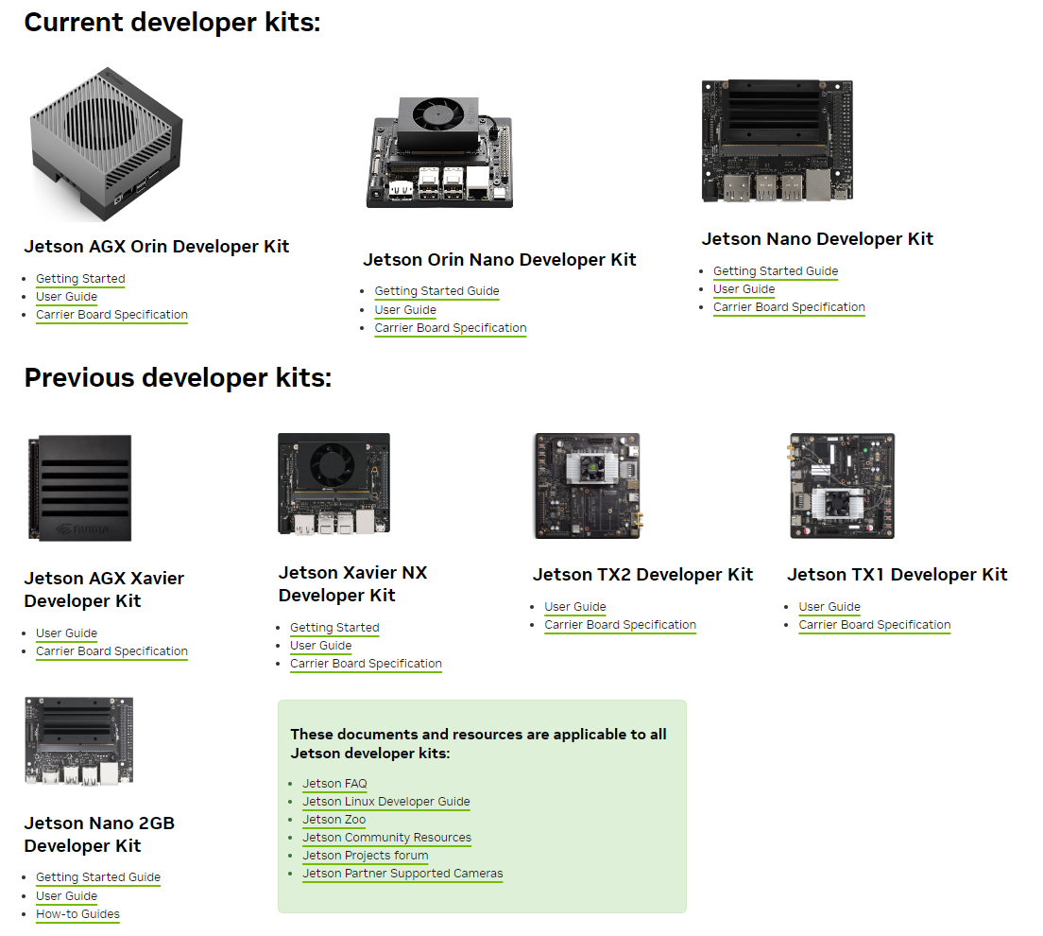
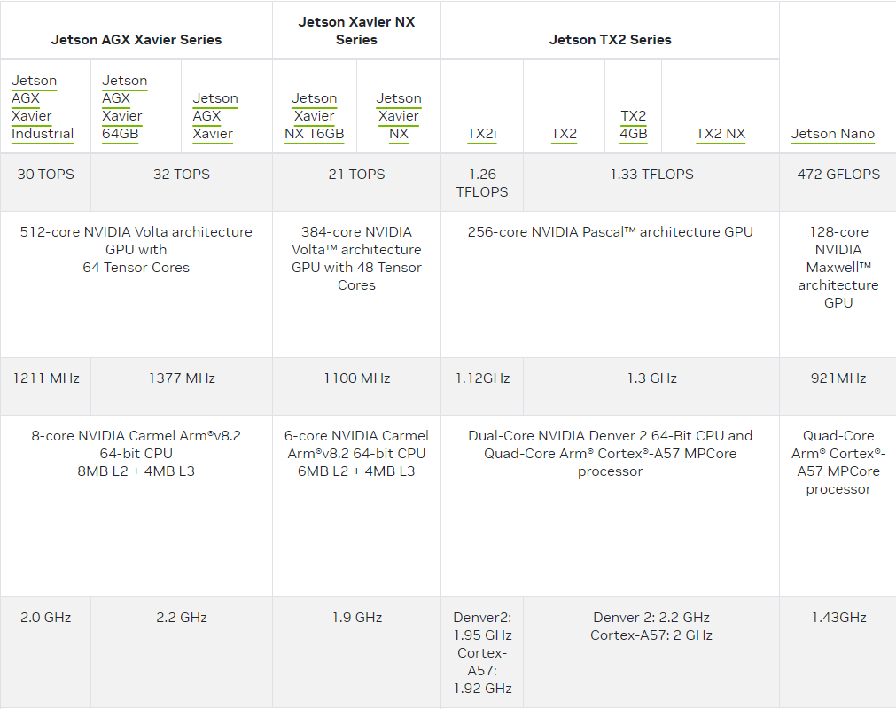
Adventages:
CUDA core → Al/Vision acceleration
Jetpack OS (3 for U16, 4 for U18, 5 for U20)
Community and examples Forums Wiki
Technical Specifications
https://developer.nvidia.com/embedded/learn/getting-started-jetson#documentation

Slide 3
Jetson Nano Introduction
https://developer.nvidia.com/embedded/learn/get-started-jetson-nano-devkit

Slide 4
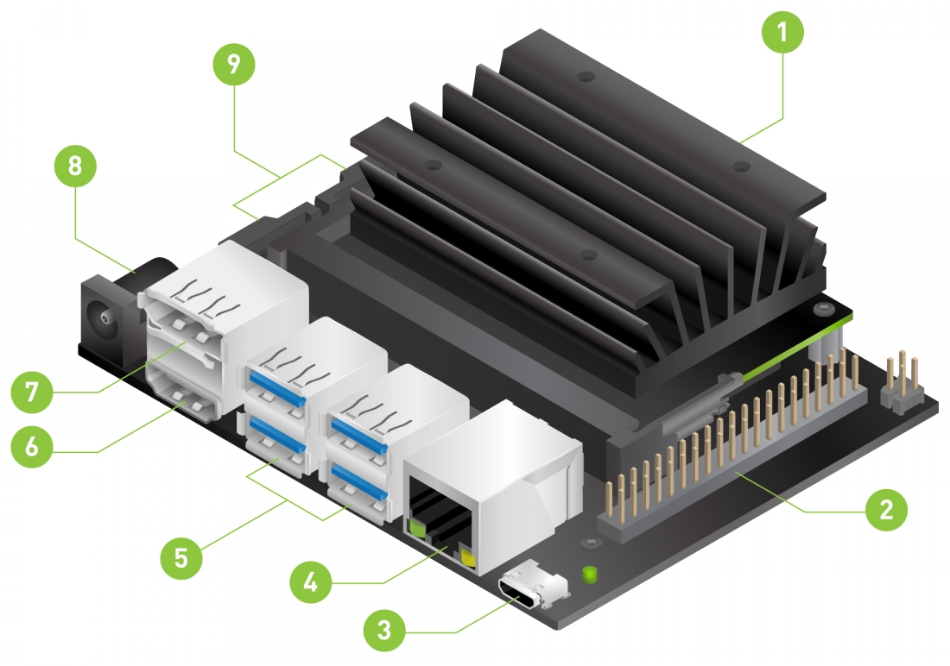
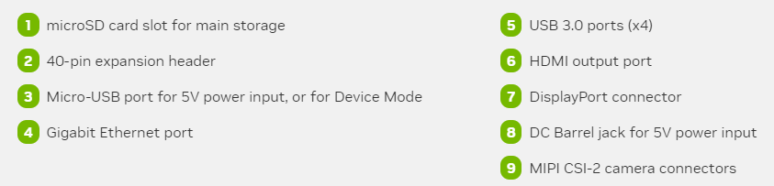

Slide 5
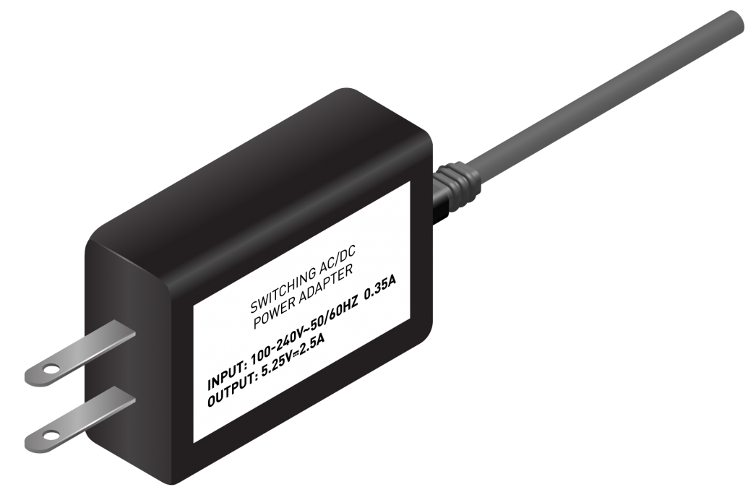
Micro-USB Power Supply
You’ll need to power the developer kit with a good quality power supply that can deliver 5V⎓2A at the developer kit’s Micro-USB port. Not every power supply promising “5V⎓2A” will actually do this.
As an example of a good power supply, NVIDIA has validated Adafruit’s 5V 2.5A Switching Power Supply with 20AWG MicroUSB Cable (GEO151UB-6025). It was specifically designed to overcome common problems with USB power supplies; see the linked product page for details.

Slide 6
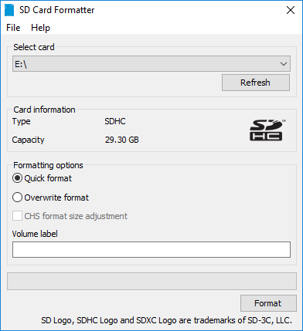
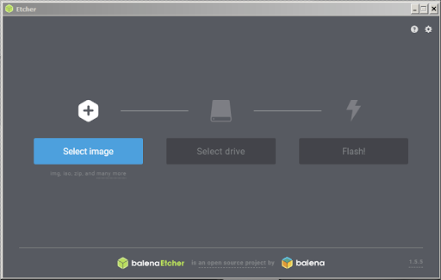
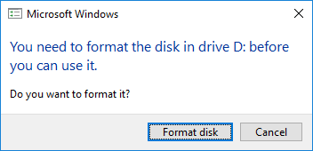
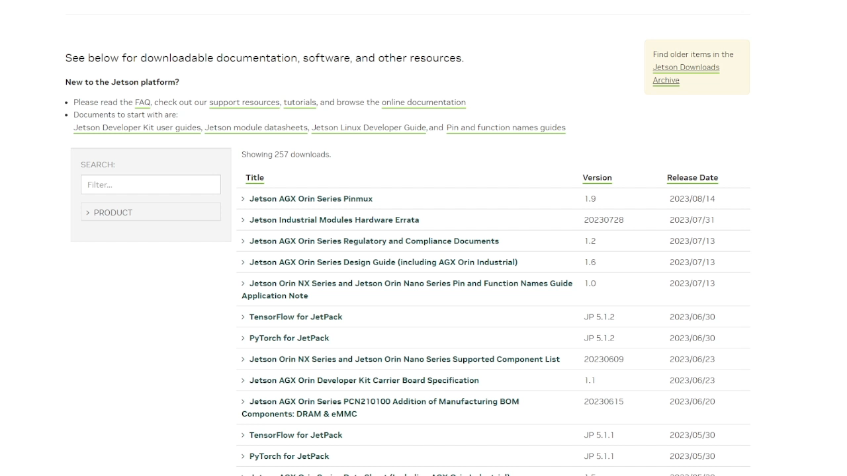
1. Prepare the software
SD Memory Card Formatter
Etcher
2. Prepare the image
Jetson Download Center

Slide 7
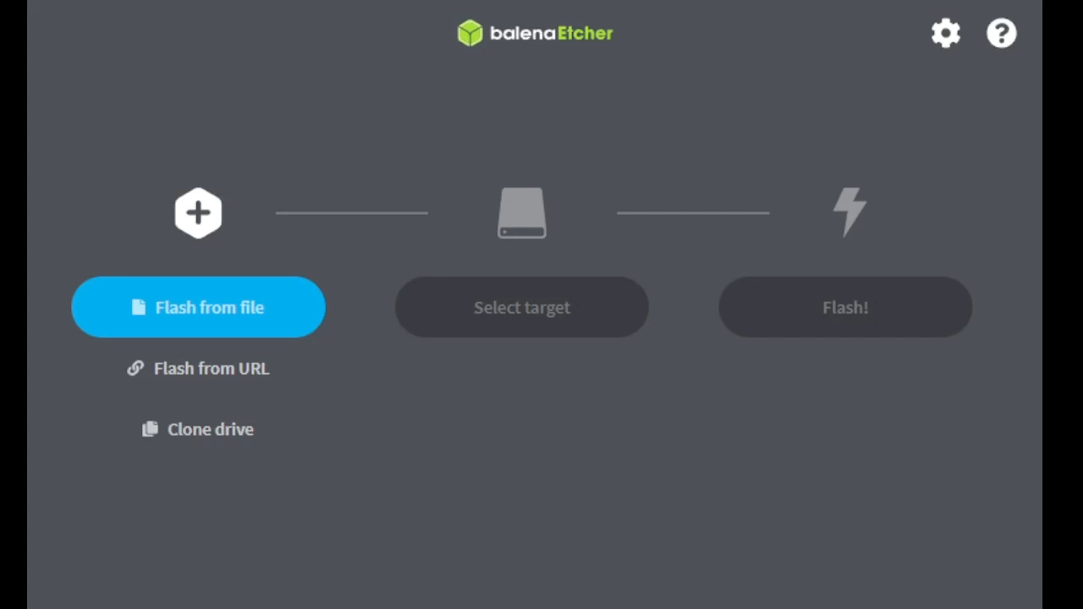

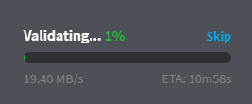
1. Format SDcard
2. Flashing the Image
3. Ready to Go

Slide 8
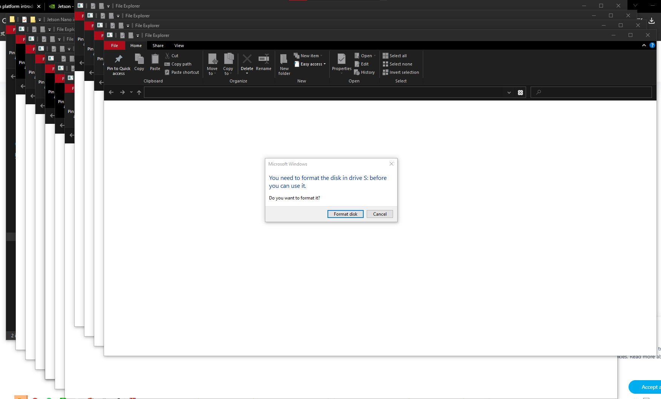
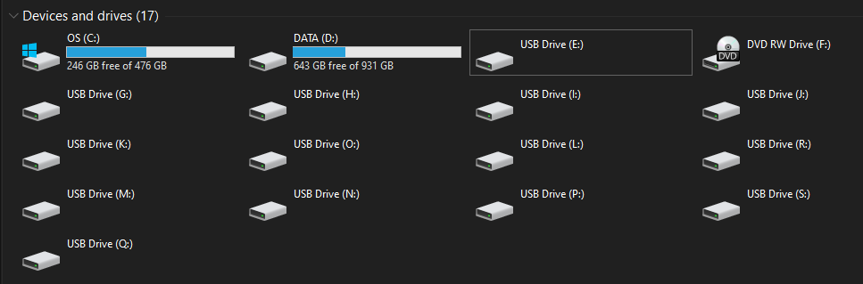

Slide 9
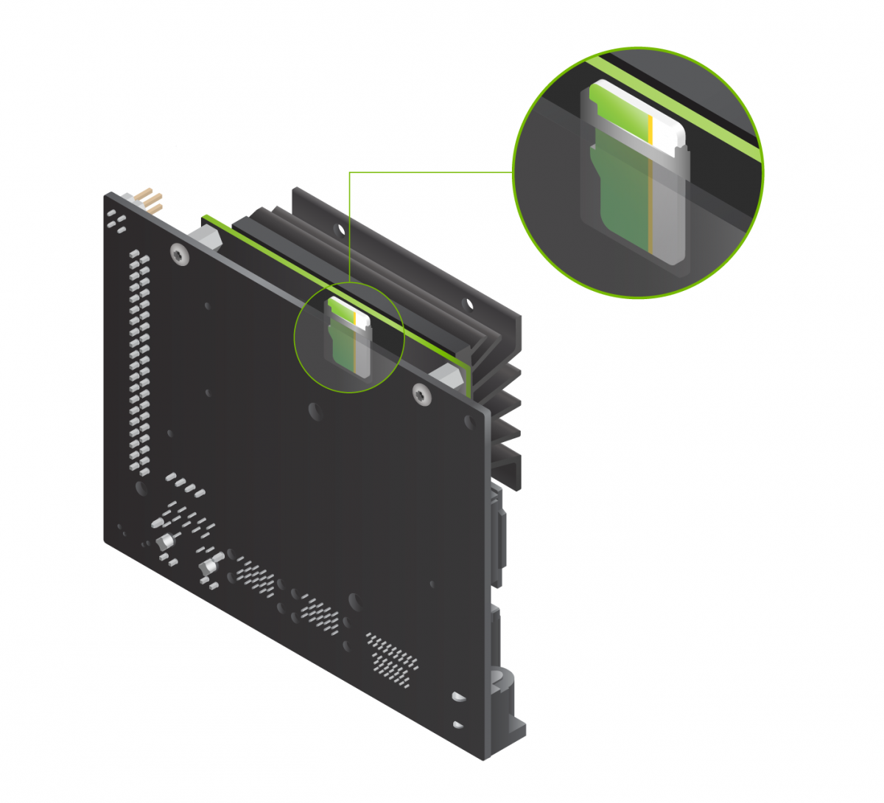
關電進行 !!!!

Slide 10
Q&A

Slide 11
Jetpack OS
Boot-up
Basic command

Slide 12


Slide 13
Basic command
Command | Description
sudo | Run as Root
ls | List the contents of the directory.
cd | Change to a different directory.
mkdir | Create a new directory.
touch | Create a new empty file or update the modification time of a file.
cp | Copy a file or a directory.
mv | Can be used to move or rename a file or directory.
nano | A simple text editor which can be used to create or edit files.
cat | Shows the contents of a file.
grep | Sorts the output based on a given pattern.
chmod | Change the permission of a file or a directory.
chown | Change the owner of a file or a directory.
tar | Create or extract a tar archive file.
zip | Creates a zip file.
unzip | Extract the zip archive file.
ssh | Securely connect to a remote server.
ping | Test the connectivity between two devices over the network.
su | Switch to another user account.
netstat | Shows network connections, routing tables, and network stats.
top | Shows the live status of system resources and ongoing processes.
free | Displays the information about the system's memory usage.
df | Gets the disk usage information.
kill | Used to kill the ongoing process.
find | Searches for a file or a directory based on given arguments.
history | Gets the list of previously executed commands.
apt apt-get | Ubuntu package manager which is used to install, update and remove packages.

Slide 14
ROS Installation
https://wiki.ros.org/melodic/Installation/Ubuntu 做控制跟VIO/VSLAM基本上會用到
1. ROS安裝與確認
2. Catkin tools 安裝

Slide 15
sudo sh -c 'echo "deb http://packages.ros.org/ros/ubuntu $(lsb_release -sc) main" > /etc/apt/sources.list.d/ros-latest.list'
sudo apt install curl
curl -s https://raw.githubusercontent.com/ros/rosdistro/master/ros.asc | sudo apt-key add -
sudo apt update
sudo apt install ros-melodic-desktop-full
echo "source /opt/ros/melodic/setup.bash" >> ~/.bashrc
source ~/.bashrc

Slide 16
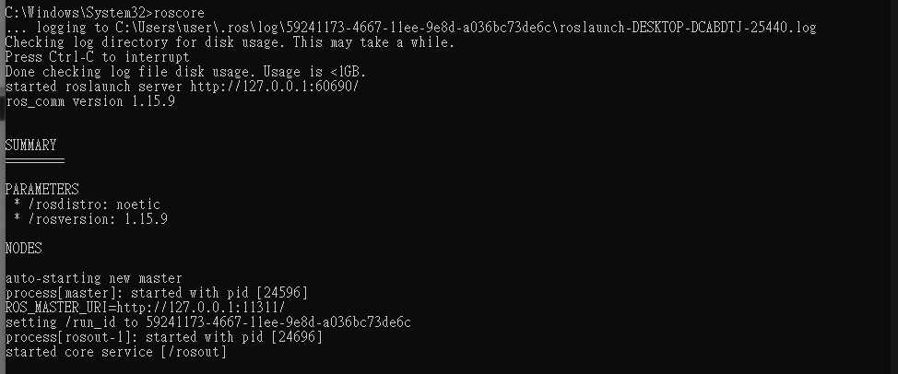
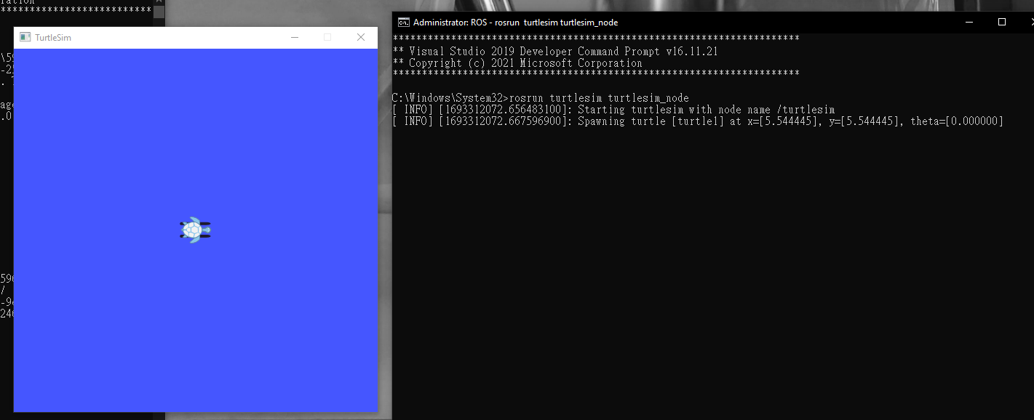
sudo apt install python-rosdep python-rosinstall python-rosinstall-generator python-wstool build-essential
sudo apt install python-rosdep
sudo rosdep init
rosdep update
A Terminal: roscore
B Terminal: rosrun turtlesim turtlesim_node

Slide 17
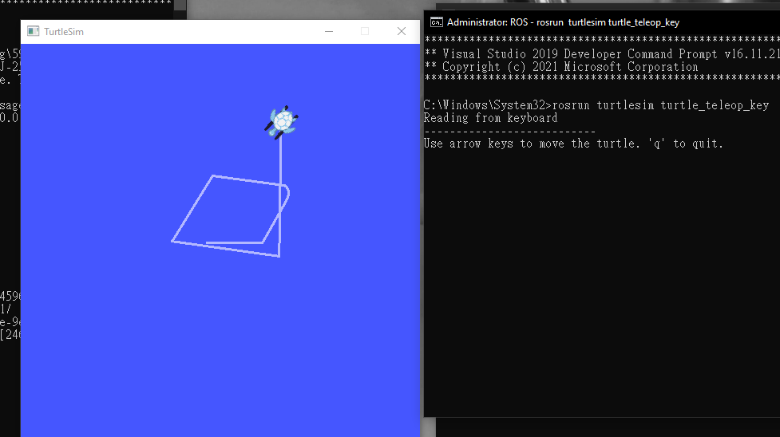
rosrun turtlesim turtle_teleop_key

Slide 18
疑難排解：
apt/apt-get/dpkg－Unable to lock the administration directory
https://www.ltsplus.com/linux/fix-unable-to-lock-the-administration-directory

Slide 19
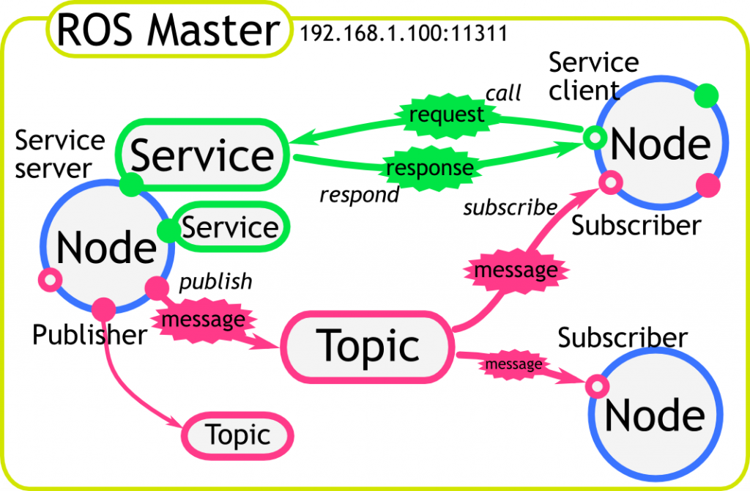

Slide 20
catkin_make and catkin tools

Slide 21
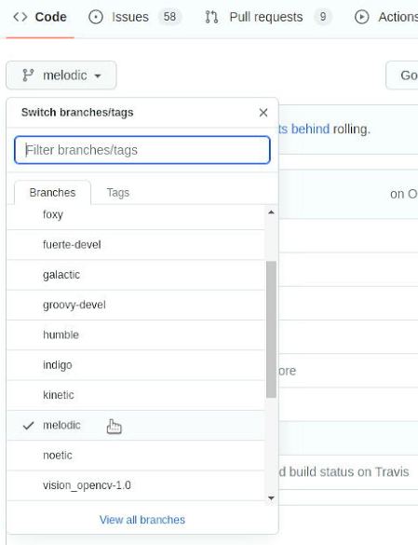
sudo apt-get install python3-catkin-tools
sudo apt-get install python-catkin-tools
Go to home and open the Terminal:
mkdir catkin_ws && cd catkin_ws
mkdir src && cd src
git clone https://github.com/ros-perception/vision_opencv.git
Unsupported package ‘ament_cmake’ → error cause by install the ROS2 Version
git checkout melodic
git pull
cv_bridge not compatible with opencv4:
https://zhuanlan.zhihu.com/p/392939687

Slide 22
Q&A

Slide 23
Useful Tools
Swap Setting
Jtop tools

Slide 24
Swap Setting
Turn off all running swap processes : swapoff -a
Resize swap : fallocate -l 1G /swapfile (change 1G to the gigabyte size you want it to be)
CHMOD swap : chmod 600 /swapfile
Make file usable as swap: mkswap /swapfile
Active the swap file : swapon /swapfile
Thats it! Some commands may take some time to be executed, just wait patiently for the commands to finish.
To verify your swap size run the following command and you will see the swap size: free -m

Slide 25
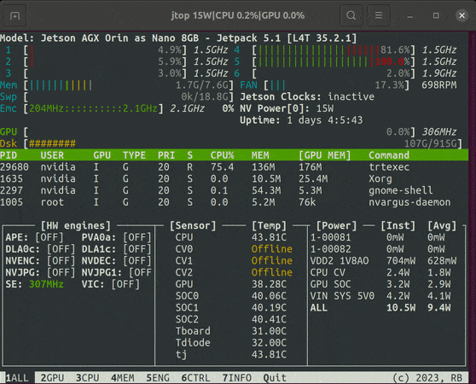
Jtop tools
https://github.com/rbonghi/jetson_stats
sudo apt-get install python3-pip
sudo pip3 install jetson-stats
sudo jtop

Slide 26
Q&A

Slide 27
GY-521 with Arduino
What’s the I2C
GY-86 Introduction(just take easy on it)
GY-86 Document
Simple code for getting [p q r] And [dx dy dz]

Slide 28
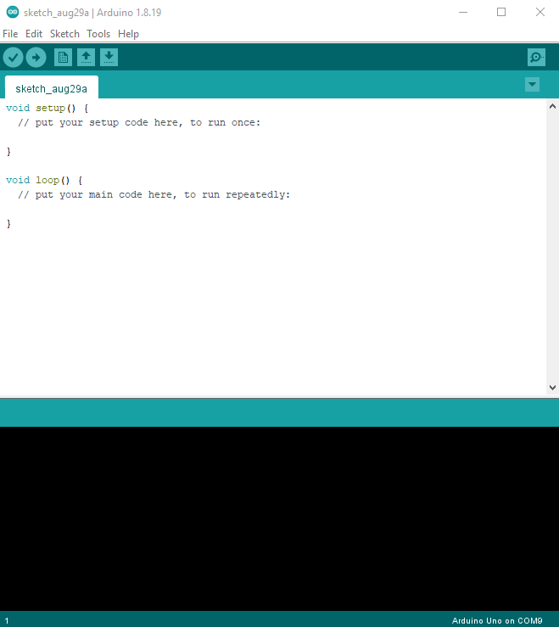
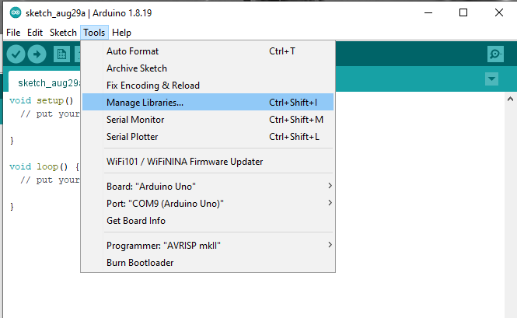
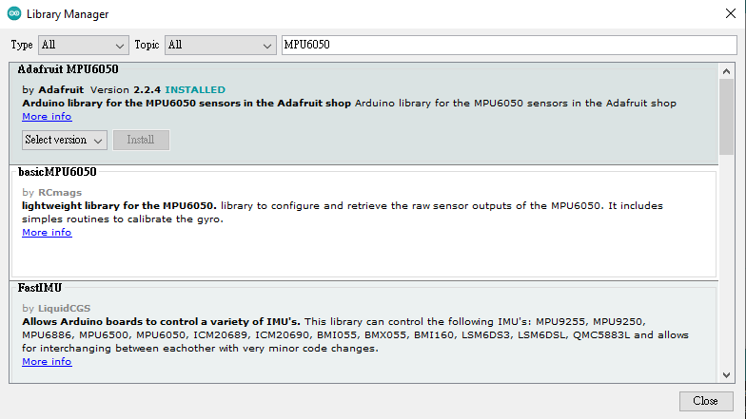
Prepare software
Arduino IDE
In depended library

Slide 29
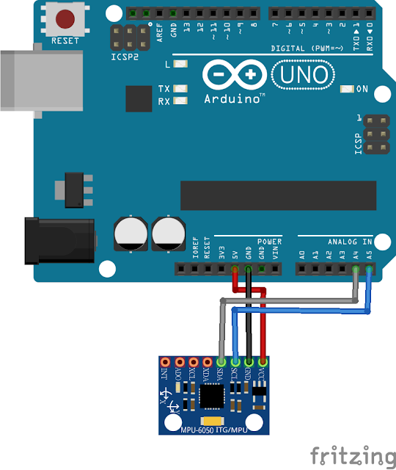
Prepare hardware
Arduino | MPU-6050
5V | VCC
GND | GND
A5 | SCL
A4 | SDA

Slide 30
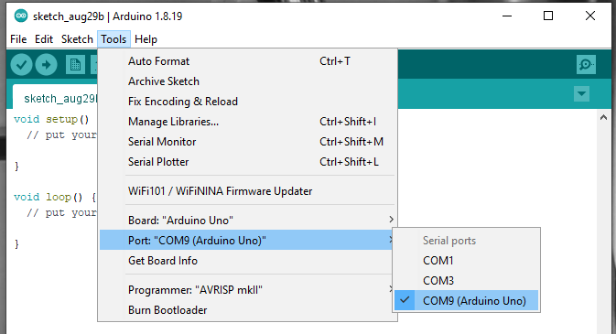
Prepare hardware
USB

Slide 31
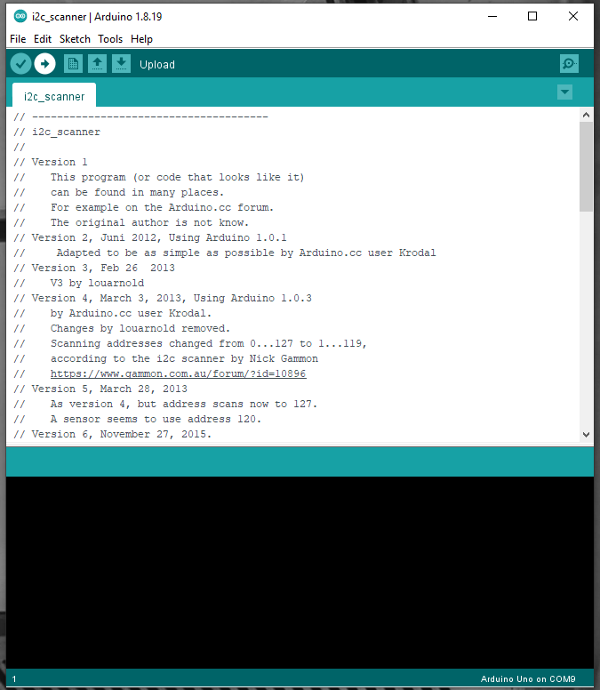
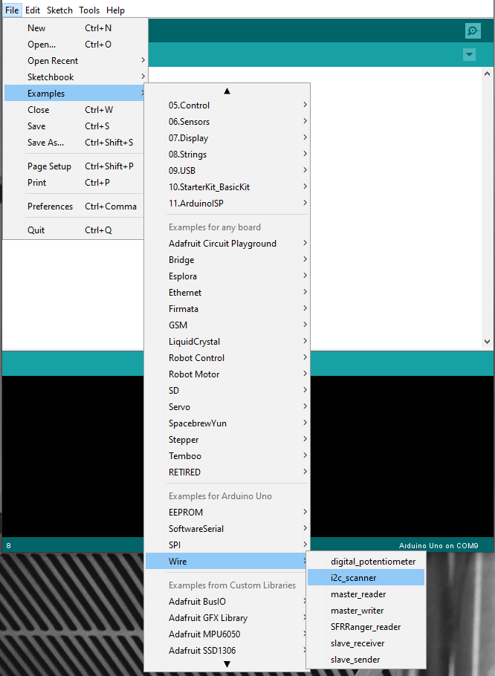
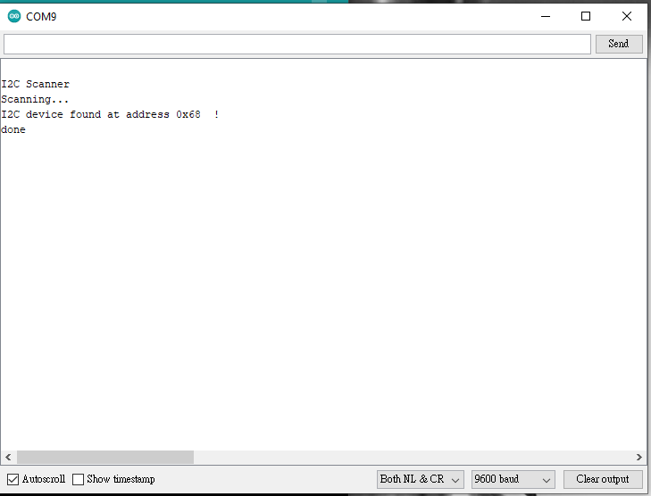
CHK hardware & software

Slide 32
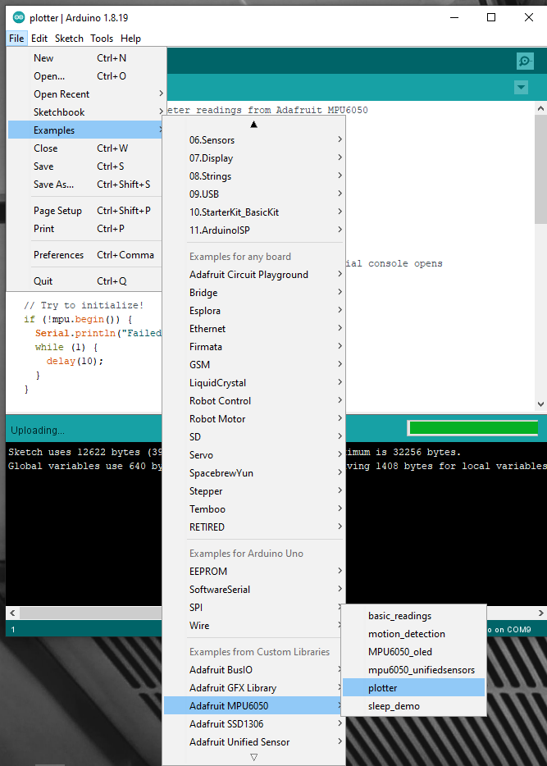
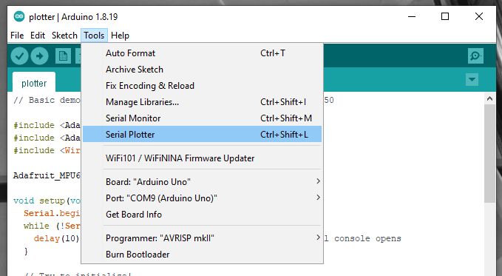
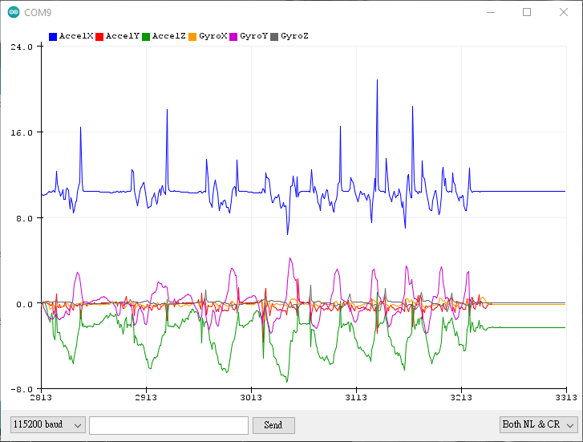
CHK hardware & software

Slide 33
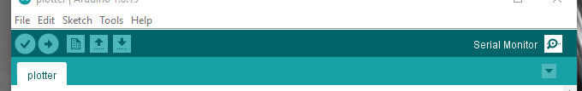
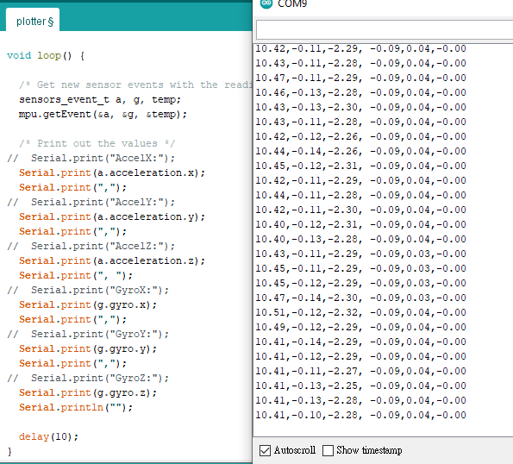
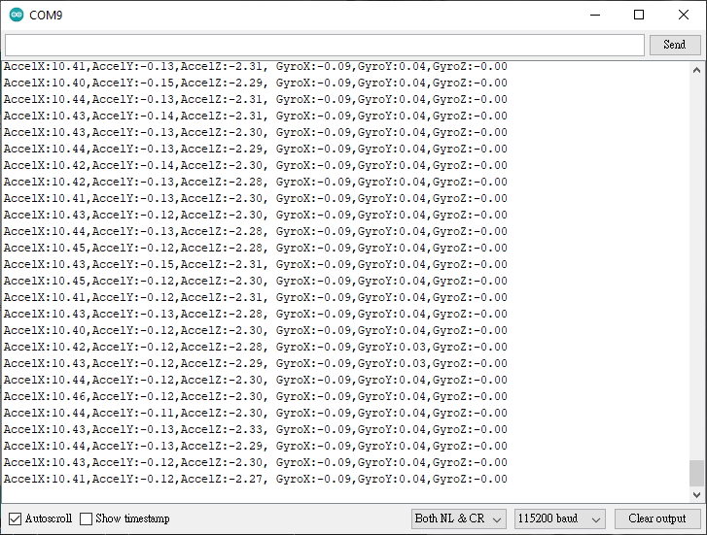
CHK hardware & software

Slide 34
CHK hardware & software
IMU資料以字串傳輸
PySerial處理
存成CSV or 接入深度學習網路

Slide 35
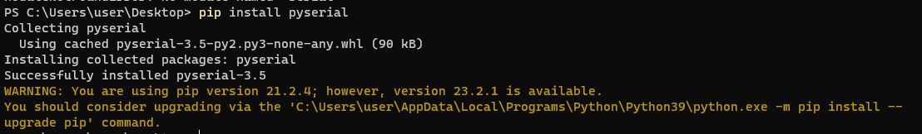
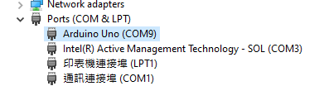
Python setup
Install pyserial
pip install pyserial
Check the port

Slide 36
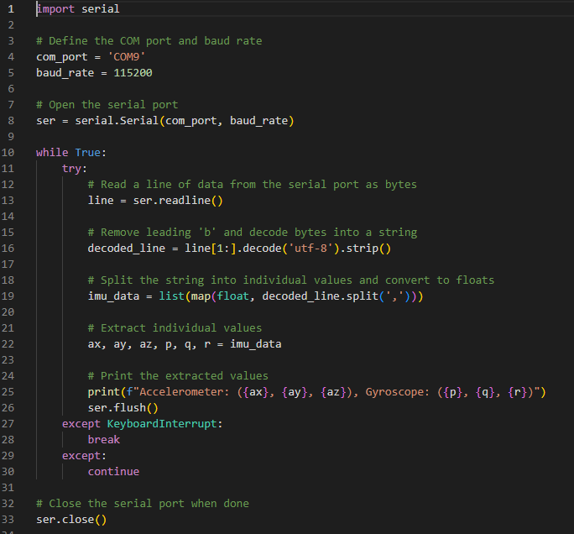
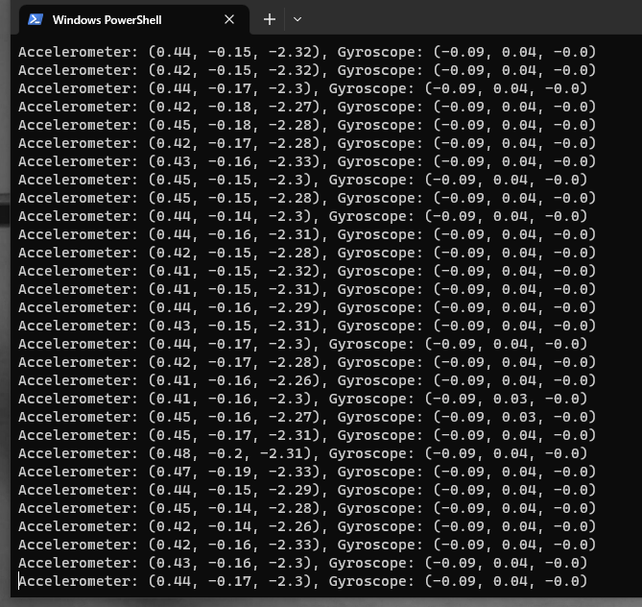
Python setup

Slide 37
Little Summary

Slide 38
Hardware connecting(Jetson Nano & Arduino)
USB Connection
Python-reading char via UART(Pyserial)

Slide 39
Deep Learning Model for Motion recognizing

Slide 40
Deep-Learning-Based Character Recognition from Handwriting Motion Data Captured Using IMU and Force Sensors
https://www.mdpi.com/1424-8220/22/20/7840
Application of Deep Learning to IMU sensor motion
https://ieeexplore.ieee.org/abstract/document/9020363
Learning Sensor Interdependencies for IMU-to-Segment Assignment
https://ieeexplore.ieee.org/abstract/document/9516022

Slide 41
Q&A

